Slide 1

Airline safety - Executive summary
Joel McMillin

Slide 2


Introduction
Our Industry – Our Brand: A Perception Problem
Waning Consumer Confidence in Airline Safety
Decreased Air Travel
Competition from Auto Industry

Slide 3
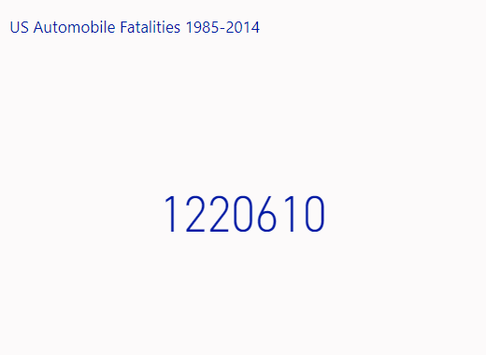
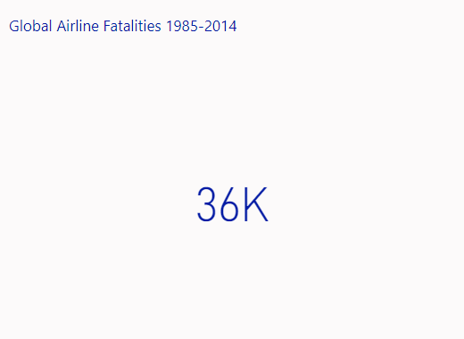
The numbers
The Reality of Auto vs Airline Safety – the Numbers
Airline Fatalities = 3% of Auto Fatalities over a 30-Year period

Slide 4
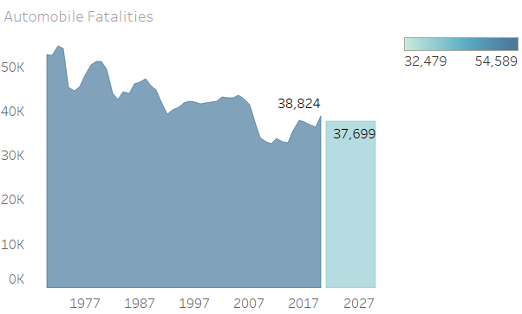
automobile safety across time
Annual Auto Fatalities trend higher than Total Fatalities from Air Travel
Forecasts through 2030 show annual Auto Fatalities are higher than 30-year Total for Airline Fatalities

Slide 5
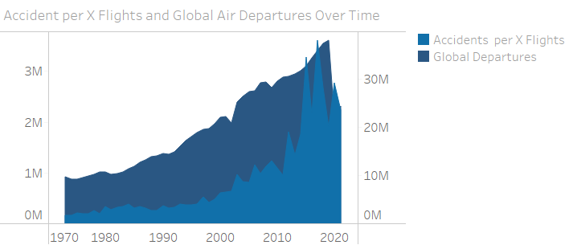
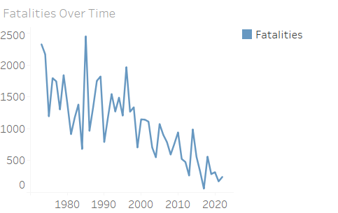
flight Safety across time
Scaled to Show Trends
Total Flights increase and Airline Accidents decrease during the same period
Enhanced safety and reduced risk as Air Travel increases

Slide 6
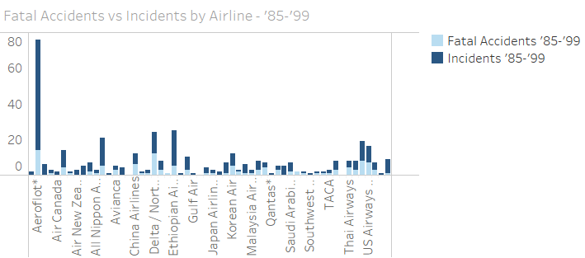
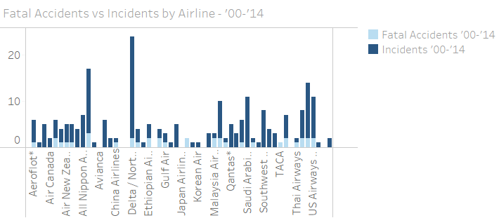
Airline safety across time
Across multiple airlines - Fatal Accidents are a fraction of total Airline Incidents
Total Airline Incidents decrease over time across all airlines

Slide 7

Airline revenue over time
Year | Revenue
2020 | $130.85 billion
2019 | $248 billion
2018 | $240 billion
2017 | $222.24 billion
2016 | $209.3 billion
2015 | $205.36 billion
2014 | $207.71 billion
2013 | $200.24 billion
2012 | $196.11 billion
2011 | $193.04 billion
2010 | $174.68 billion
Steady Increase in Revenue
2010-2019
Covid-19 Travel Restrictions
2020
Decreased Revenue

Slide 8
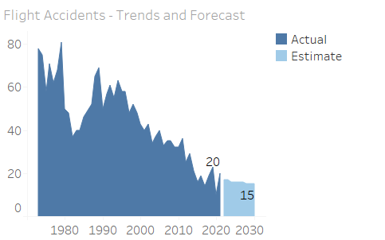
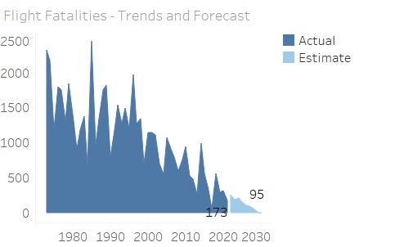
Trend analysis and forecasting
Prior Trends and Forecasting show increased safety over time
Decreases in Incidents and Fatalities heading to 2030

Slide 9

path forward
Post-Covid Travel and Revenue Rebound
Air Travel Remains Safest by the Numbers
Our Industry – Our Brand: Perception Recovery
Educate Consumers
Enhance Safety
Emphasize Air Travel as the Best Option

Slide 10
references
“Accidents and Fatalities per Year.” Google Sheets, Google, https://docs.google.com/spreadsheets/d/1SDp7p1y6m7N5xD5_fpOkYOrJvd68V7iy6etXy2cetb8/edit#gid=661081734.
Fivethirtyeight. “Data/Airline-Safety at Master · Fivethirtyeight/Data.” GitHub, https://github.com/fivethirtyeight/data/tree/master/airline-safety.
Flynn, Jack. “Airline Industry Statistics [2023]: 28 Facts to Know before You Fly.” Zippia Airline Industry Statistics 2023 28 Facts To Know Before You Fly Comments, https://www.zippia.com/advice/airline-industry-statistics/.
“Motor Vehicle Fatality Rate in U.S. by Year.” Wikipedia, Wikimedia Foundation, 17 Jan. 2023, https://en.wikipedia.org/wiki/Motor_vehicle_fatality_rate_in_U.S._by_year.
Santaella-Tenorio, Julian, et al. “US Traffic Fatalities, 1985-2014, and Their Relationship to Medical Marijuana Laws.” American Journal of Public Health, U.S. National Library of Medicine, Feb. 2017, https://www.ncbi.nlm.nih.gov/pmc/articles/PMC5227945/.

